Slide 1

The Zen of Coding
Day 1
Rutgers Coding Bootcamp | January 25, 2016
© 2016 | RCB - All Rights Reserved
Notes:
Start at 6:45 PM

Slide 2


Introduce Yourselves!
Name
Location
Background (Career, Education, Interests)
Why learn web development?
© 2016 | RCB - All Rights Reserved
© 2016 | RCB - All Rights Reserved
Notes:
6:45-7:00 PM

Slide 3

Instructor = …?
Ahmed Haque
BS in Biomedical Engineering from Texas A&M
PhD Candidate in Bioengineering from Rice U.
Over 7 years coding, (with plenty of experience being a n00b at it.)
LOVES teaching
Secretly, an aspiring zen master
© 2016 | RCB - All Rights Reserved
© 2016 | Rutgers Coding Bootcamp - All Rights Reserved
Notes:
6:45-7:00 PM

Slide 4
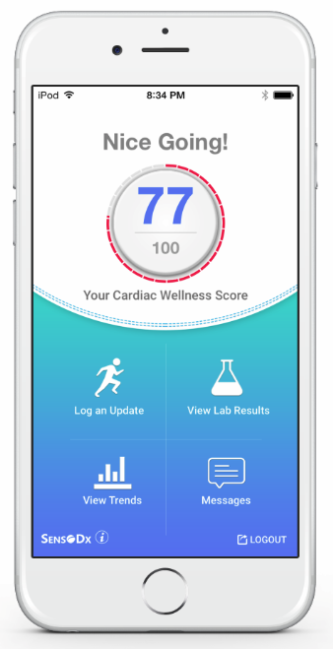
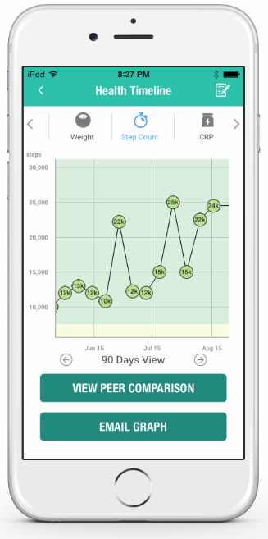
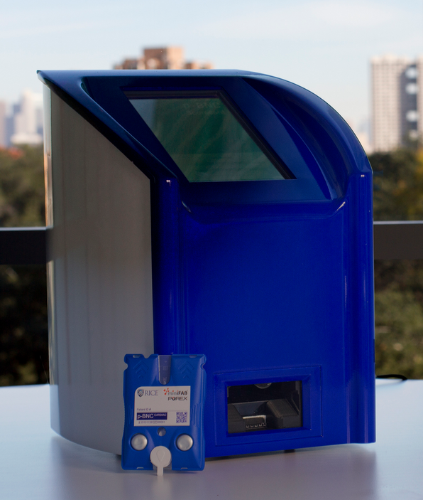
My Dissertation… in 6 seconds.
Biomarkers
Coding
Awesome Health (Yay!)
© 2016 | RCB - All Rights Reserved
Notes:
6:45-7:00 PM

Slide 5
The Path of Learning
© 2016 | RCB - All Rights Reserved
Notes:
7:00 – 7:05

Slide 6
Your Goals for the Path
“To land a solid career.. and be able to support a family.”
“Hope to make something of myself one day…”
“An opportunity to be more creative in my day-to-day work.”
“…to get a better paying job.”
“I want nothing more in the entire world than to be a game designer.”
“Change careers and become a web developer.”
“…to build mastery. To learn a skill that I haven’t yet explored.”
“[a chapter] better than the last.”
© 2016 | RCB - All Rights Reserved
Notes:
7:00 – 7:05

Slide 7
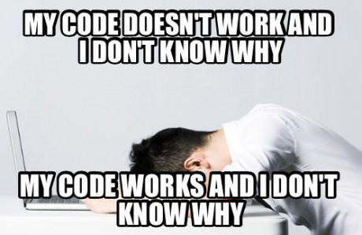
Obstacle #1 – The Great Confusion
© 2016 | RCB - All Rights Reserved
Notes:
7:00 – 7:05

Slide 8
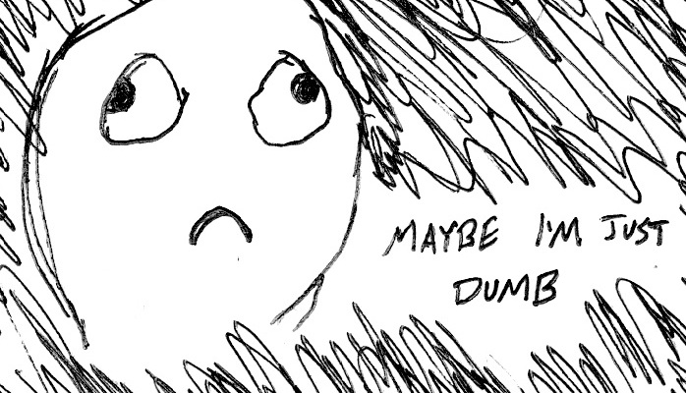
Obstacle #2 – The Great Doubt
© 2016 | RCB - All Rights Reserved
Notes:
7:00 – 7:05

Slide 9
Learning is “Frustrating”
“You can’t tell whether you’re learning something when you’re learning it—in fact, learning feels a lot more like frustration.”
“What I’ve learned is that during this period of frustration is actually when people improve the most, and their improvements are usually obvious to an outsider. If you feel frustrated while trying to understand new concepts, try to remember that it might not feel like it, but you’re probably rapidly expanding your knowledge.”
Phillip Dickey, Author of Write Modern Web Apps with the MEAN Stack: Mongo, Express, AngularJS, and Node.JS
© 2016 | RCB - All Rights Reserved
Notes:
7:00 – 7:05

Slide 10
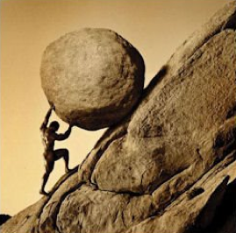
Advice for the Journey
Throughout this course, always remember to:
Work Hard!!
© 2016 | RCB - All Rights Reserved
Notes:
7:00 – 7:05 PM

Slide 11
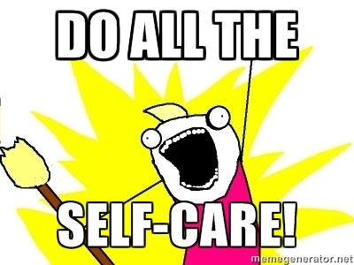
Advice for the Journey
Throughout this course, always remember to:
Work Hard!!
Appreciate your successes
© 2016 | RCB - All Rights Reserved
Notes:
7:00 – 7:05 PM

Slide 12

Advice for the Journey
Throughout this course, always remember to:
Work Hard!!
Appreciate your successes
Trust yourself
© 2016 | RCB - All Rights Reserved
Notes:
7:00 – 7:05 PM

Slide 13
Course Structure
Notes:
7:05 – 7:10

Slide 14
Daily Schedule
For each class we’ll run through the following:
Set Objectives
Brief Background Lecture
Watch Me / Coding Demos
Code Discussions
In-Class Exercises
Project Work
© 2016 | RCB - All Rights Reserved
© 2016 | Rutgers Coding Bootcamp - All Rights Reserved

Slide 15
Daily Schedule
For each class we’ll run through the following:
Set Objectives
Brief Background Lecture
Watch Me / Coding Demos
Code Discussions
In-Class Exercises
Project Work
The Super Important Stuff!!!
i.e. Always be coding!
© 2016 | RCB - All Rights Reserved
Notes:
7:05 – 7:10

Slide 16
Today’s Objectives
Students will get to know their classmates, Instructor, TA's, and Support Team.
Students will resolve any issues regarding pre-work and computer setup
Students will understand the course structure.
Students will learn common Terminal (Mac) / Git Bash (Windows) commands to set up your file and folder structures.
Students will be able to use common Terminal (Mac) / Git Bash (Windows) commands for web development.
Students will be able to set up a basic HTML document.
© 2016 | RCB - All Rights Reserved
© 2016 | Rutgers Coding Bootcamp - All Rights Reserved

Slide 17
Pre-Work!
Notes:
7:10 – 7:30

Slide 18
Software Checklist
At this point, you should have each of these installed:
Slack
Sublime Text 3
Git for Version Control
Git Bash (Windows) or Terminal (Mac)
Node.js
Heroku Toolbelt
MySQL
Heidi SQL (Windows) or Sequel Pro (Mac)
Google Chrome
© 2016 | RCB - All Rights Reserved
Notes:
7:10 – 7:30

Slide 19
Accounts Checklist
You should also now have accounts for:
GitHub (with SSH Integration)
Heroku
LinkedIn
Stack Overflow
Twitter
© 2016 | RCB - All Rights Reserved
© 2016 | Rutgers Coding Bootcamp - All Rights Reserved
Notes:
7:10 – 7:30

Slide 20
Self-Check
Let’s do some quick checks of the following
Sublime Check
Git Bash / Terminal Check
Node Check
Git Check
Heroku Check
© 2016 | RCB - All Rights Reserved
© 2016 | Rutgers Coding Bootcamp - All Rights Reserved
Notes:
7:30 – 7:35

Slide 21
Break!!!
Notes:
7:50 – 8:05 PM

Slide 22
On the Modern Web
Notes:
7:35 – 7:50 PM

Slide 23
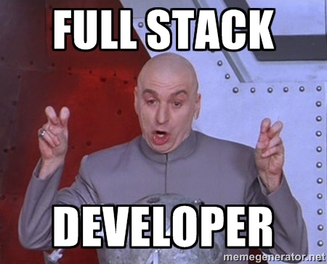
Full-Stack Development?
© 2016 | RCB - All Rights Reserved
Notes:
7:35 – 7:50 PM

Slide 24

The “Magic” of YouTube
© 2016 | RCB - All Rights Reserved
Notes:
7:35 – 7:50 PM

Slide 25
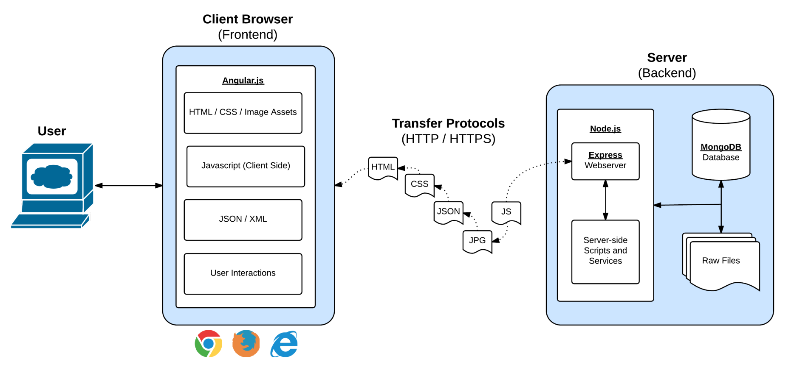
Full-Stack Development
In modern web applications there is a constant back-and-forth communication between the visuals displayed on the user’s browser (frontend) and the data and logic stored on the server (backend).
© 2016 | RCB - All Rights Reserved
Notes:
7:35 – 7:50 PM

Slide 26
Full-Stack Development
Full-Stack Development is the concept of building every aspect of the web application – from the visuals and interactions, to the data transfer and processing.
© 2016 | RCB - All Rights Reserved
Notes:
7:35 – 7:50 PM

Slide 27
Our Full-Stack Curriculum
The Browser
Dev Tools
Middleware and Servers
HTML
CSS
Javascript
Jquery
Angular
Bootstrap
SEO
Grunt
Heroku
Git
GitHub
Constructor Functions
Templating Engines
Cookies, Sessions
Test-Driven Development Node.js
MySQL
Express.js
APIs Creating & MVC
User Authentication
Databases
MySQL
MongoDB
API Interaction
APIs (Consuming)
JSON
AJAX
Cloud DBs via Parse
Javascript Objects
CS Fundamentals
Data Structures
Sorting Algorithms
Design Patterns
Cutting Edge Development
Meteor
© 2016 | RCB - All Rights Reserved
Notes:
7:35 – 7:50 PM

Slide 28
Let’s Get Crackin!
Notes:
8:05 – 8:20 PM

Slide 29

> Intro to Console
© 2016 | RCB - All Rights Reserved
Notes:
8:05 – 8:20 PM

Slide 30
> YOUR TURN!!
Assignment:
From the Terminal / Console and using only the command line, create:
A new folder with the name of first_day_stuff
A new HTML file with the name of first_day.html
Open the current folder containing the new HTML file.
Bonus:
Create multiple directories/folders with the names one_folder and second_folder in one command.
Create multiple files with the names one.html and two.html in one command in the first_day_stuff directory.
© 2016 | RCB - All Rights Reserved
Notes:
8:20 -8:35

Slide 31
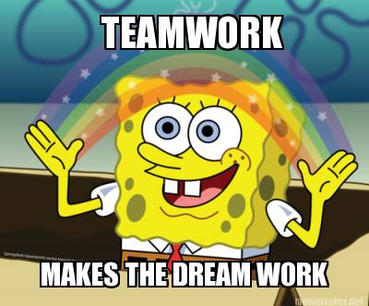
> Intro to Console
Discuss with Neighbors
© 2016 | RCB - All Rights Reserved
Notes:
8:20 -8:35

Slide 32
Hello, HTML
Notes:
8:35 – 8:50 PM

Slide 33


<title> Intro to HTML </title>
HTML is one of the three base languages behind every single website.
It defines all of the basic content and a bit of formatting.
© 2016 | RCB - All Rights Reserved
Notes:
8:35 – 8:50 PM

Slide 34
<h1> Your Turn!!! </h1>
Assignment:
In a new HTML file, create the basic structure of an HTML document and include the following in it:
DOCTYPE declaration
Head tag with a title tag
H1 tag with a title of your choice
Embed an image
Create the following three links on your page:
One link that is target="_blank" so that it opens a new tab when clicked on.
Make the second link bold.
Make the third link a placeholder so it goes nowhere.
Bonus:
Create an ordered list of steps to make a sandwich.
Create an unordered list of 5 bands/musicians you like.
Create a table with 2 columns (animal class, animal name) and have 4 rows of animals
Use an alternate way of separating links without line breaks.
Embed a Youtube video of your favorite band/musician.
© 2016 | RCB - All Rights Reserved
Notes:
8:20 -8:35

Slide 35
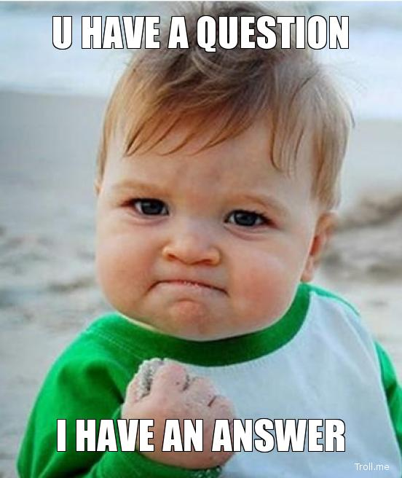
<title> Intro to HTML </title>
How’d it go?
© 2016 | RCB - All Rights Reserved
Notes:
9:15 – 9:25 PM

Slide 36
Chrome Dev Tools

Slide 37
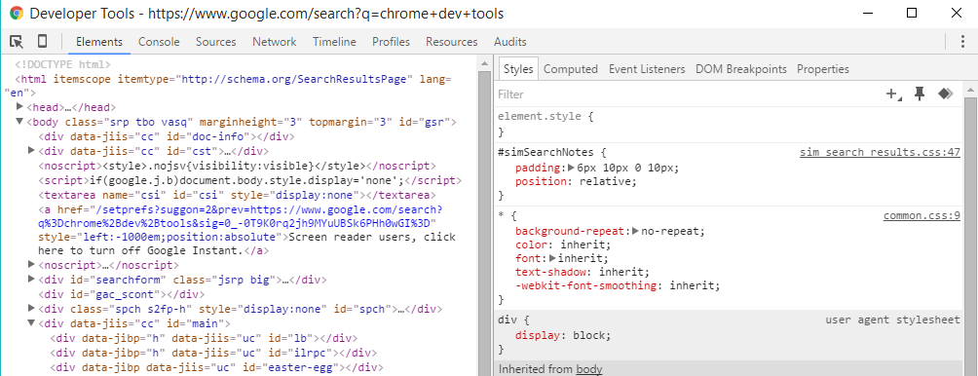
Inspector Gadget
Chrome Dev Tools allows you as a developer to dissect any website for its HTML composition and CSS.
You can (and should) use this tool to get familiar with how other websites work under the hood.
© 2016 | RCB - All Rights Reserved

Slide 38
Questions?
Notes:
9:25 – 9:40 PM

Slide 39
Homework!
Notes:
9:25 – 9:30 PM

